Slide 1
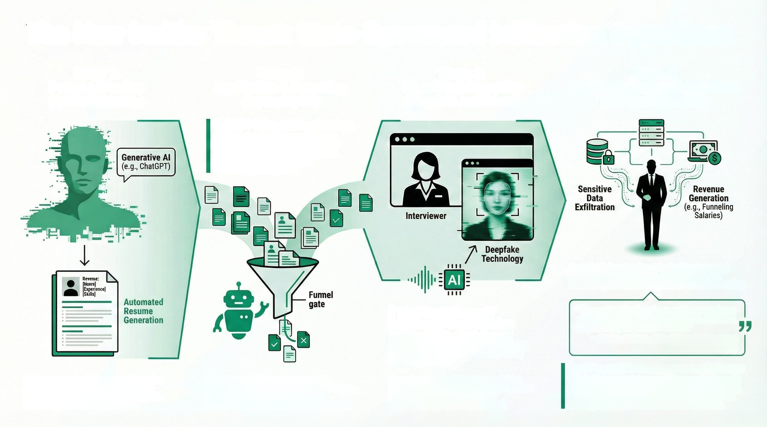
The New Insider Threat: State-Sponsored Infiltration Operations
Stage 1:
Stage 2:
Application & Screening
(Bypassing HR)
Stage 3:
Stage 4:
Legitimate Access & Operation
(The Trusted Insider)
Persona Creation
(Synthetic Identity)
Interview & Deception
(Deepfake Assistance)
1,000+ Fake Job Applications
SentinelLabs research uncovered over
1,000 job applications from fake DPRK-
linked personas attempting to infiltrate
Western firms, including major
cybersecurity companies.
Once hired, the operative gains legitimats, trusted
access to internal networks, sensitive data, and
financial systems, becoming a state-controlled insider.
1 in 4 North Korean IT
Applicants Use Deepfakes
Approximately 25% of North Korean IT
workers applying for remote jobs are using
deepfakes to conceal their identity during
the hiring process.
"The next 'insider threat' may not be an employee
gone rogue, but a foreign government's operative
disguised as your next remote hire."
- Patrick Sullivan, CTO of Security Strategy at
Akamai Technologies
State-sponsored operatives use Generative
Al tools to create entirely fabricated, yet
plausible, professional personas, complete
with automated resume generation.
The Al-generated personas are used in
large-scale application campaigns, with Al bots also completing technical and coding assessments to pass initial screening phases.
Dual-Purpose Mission: Revenue and Espionage
This insider access is leveraged for two primary goals: funneling salaries and other funds to the North Korean regime and conducting strategic expionage, such as stealing sensitive data from defense contractors.
Operatives use deepfake audio and video
technology to pass remote interviews, either
by obscuring their true identity or
impersonating a qualified individual.

